Slide 1
DATA VISUALIZATION
Data visualization techniques are essential in data science for exploring, understanding, and communicating insights from data.
They translate complex data into visual stories, making it easier to identify trends, patterns, outliers, and correlations.
The purpose of visualization are:
For Showing Relationships and Correlation
For Comparing Values
For Showing Composition (Part-to-Whole)
For Understanding Distribution

Slide 2
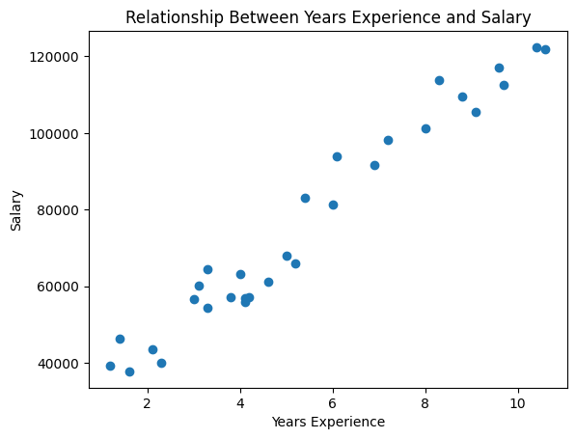
DATA VISUALIZATION: Showing Relationships and Correlation
These techniques help you understand how different variables interact with each other.
Scatter Plot: This is the classic way to show the relationship between two numerical variables. Each point represents an observation, plotted at the intersection of its x and y values.
Example: Plotting a person's 'Years of Experience' against their 'Salary' to see if they are positively correlated.
https://medium.com/@wisnupo/simple-linear-regression-using-python-analysis-of-years-of-experience-on-salary-earned-192ce4bdf78c

Slide 3
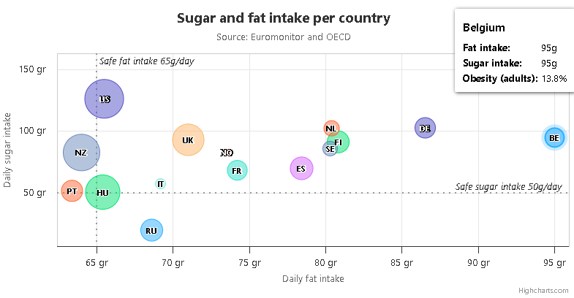
DATA VISUALIZATION: Showing Relationships and Correlation
Bubble Chart: A variation of the scatter plot where a third variable is represented by the size of the bubbles.
Example: A plot of ‘Daily fat intake’ vs. ‘Daily sugar intake’ in different countries, where the bubble size represents the ‘Obesity(%)’.

Slide 4
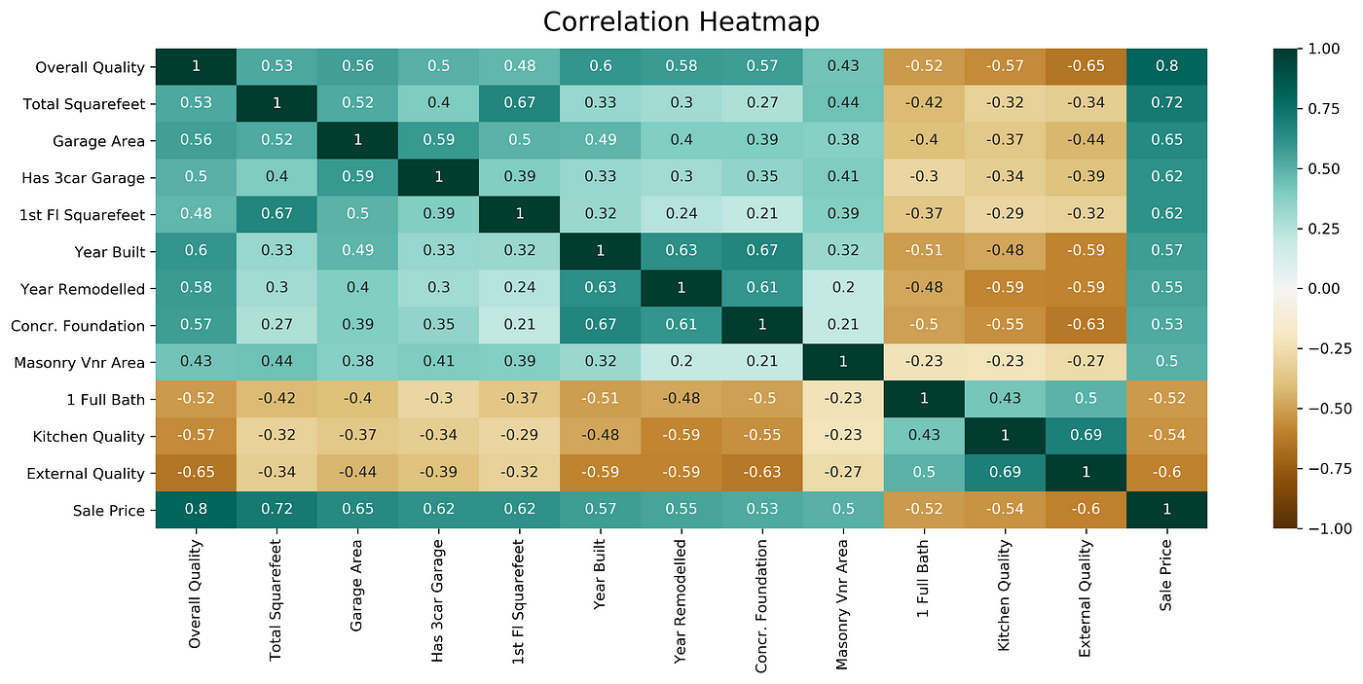
DATA VISUALIZATION: Showing Relationships and Correlation
Heat Map: A matrix where individual values are represented by colors. It's excellent for showing the correlation between many variables at once.
Example: A correlation matrix of all features in a housing dataset. Darker colors might show a strong positive correlation between 'Square Footage' and 'Price'.
https://medium.com/@szabo.bibor/how-to-create-a-seaborn-correlation-heatmap-in-python-834c0686b88e

Slide 5
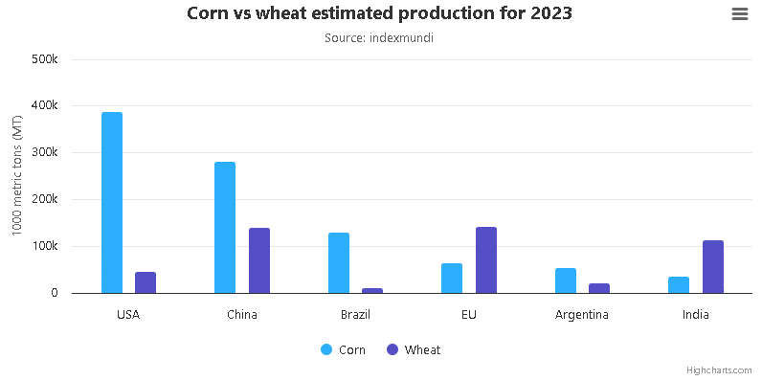
DATA VISUALIZATION: For Comparing Values
These techniques are used to compare the magnitude of different categories or track changes over time.
Bar Chart: Perfect for comparing quantities across distinct categories. The length of the bar is proportional to the value it represents..

Slide 6
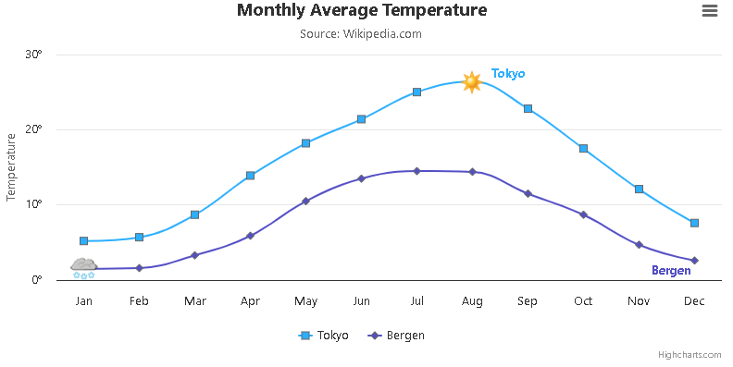
DATA VISUALIZATION: For Comparing Values
Line Chart: Best for showing trends over a continuous interval, most often time. It connects a series of data points with a line.

Slide 7
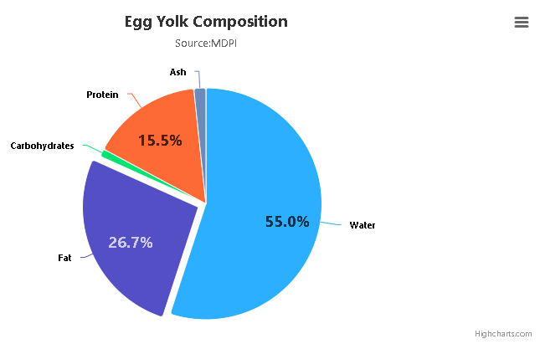
DATA VISUALIZATION: For Showing Composition (Part-to-Whole)
These techniques illustrate how a total amount is divided into parts.
Pie Chart: A circular chart that shows the percentage contribution of different categories to a whole. It's best used for a small number of categories.

Slide 8
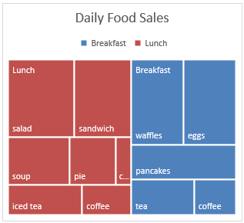
DATA VISUALIZATION: For Showing Composition (Part-to-Whole)
Treemap: An effective alternative to a pie chart, especially for hierarchical data. It uses nested rectangles whose area represents their proportion of the whole.
https://support.microsoft.com/en-us/office/create-a-treemap-chart-in-office-dfe86d28-a610-4ef5-9b30-362d5c624b68

Slide 9
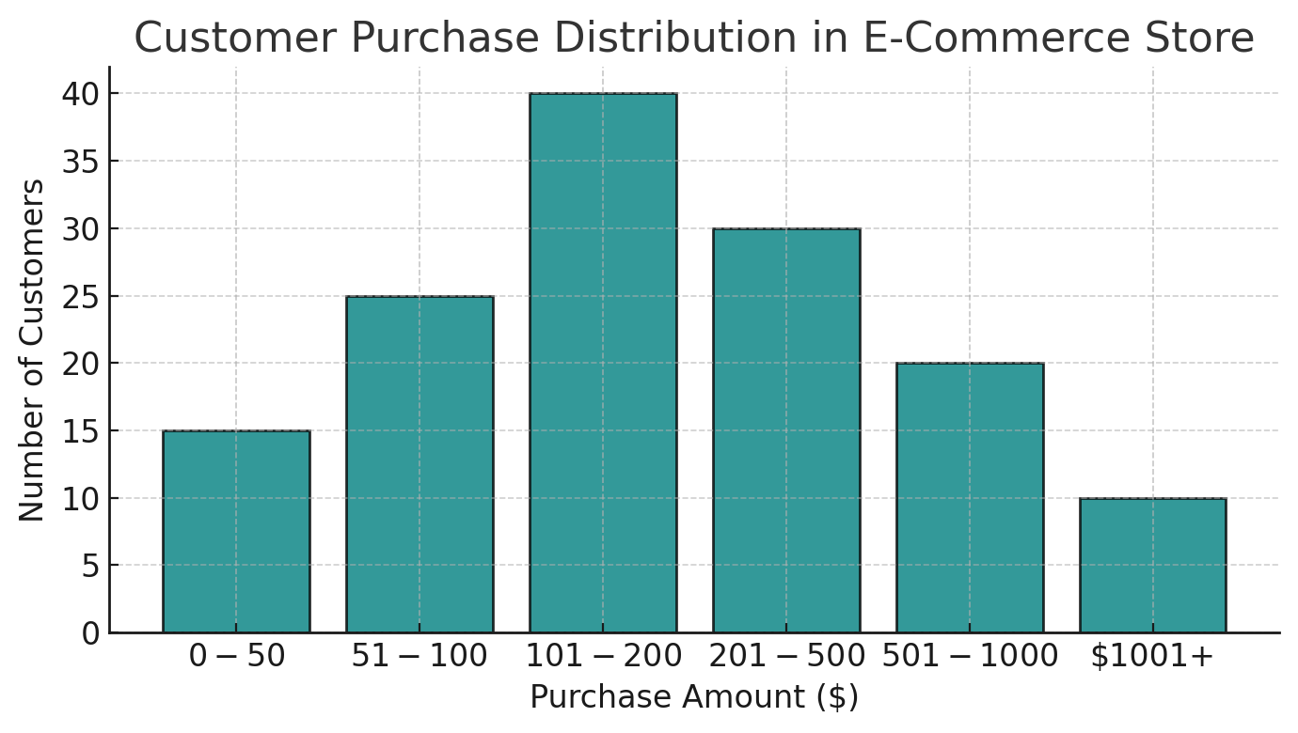
DATA VISUALIZATION: For Understanding Distribution
These techniques help you understand how a single variable is spread out.
Histogram: This looks like a bar chart but shows the frequency distribution of a single continuous variable. It groups numbers into ranges (bins) and the height of the bar shows how many data points fall into that range.
https://www.appliedaicourse.com/blog/historgam/

Slide 10
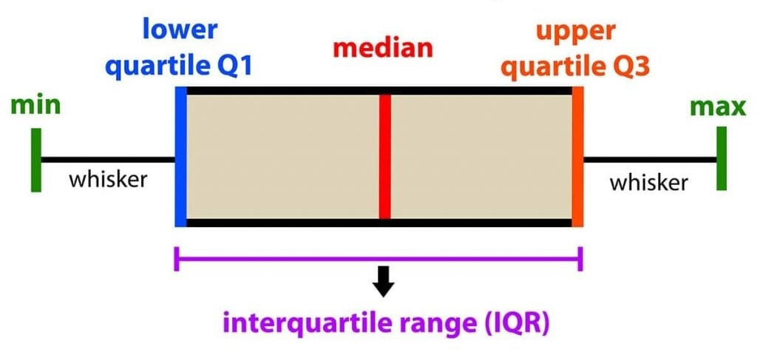
DATA VISUALIZATION: For Understanding Distribution
Box Plot (Box-and-Whisker Plot): Provides a concise summary of a variable's distribution. It shows the median, quartiles (25th and 75th percentiles), and outliers in a single visualization.
https://www.simplypsychology.org/boxplots.html

